Slide 1
Systemic Lupus Erythematosus
Mustafa E. Al-Badran
CABM FIBMS
Internist & Rheumatologist

Slide 3
Epidemiology
The prevalence ranges from 0.03% in Caucasians to 0.2% in Afro- Caribbean's (1:250)
SLE About 9 times more common in women
Peak age at onset is between 20 and 30 years
Notes:
SLE is associated with considerable morbidity and a fivefold increase in mortality compared to age- and gender-matched controls, mainly because of an increased risk of premature cardiovascular mortality

Slide 4
Pathophysiology
Autoantibody production
Defects in apoptosis or in the clearance of apoptotic cells, which causes in exposure of intracellular antigens on the cell surface, leading to polyclonal B- and T-cell activation and autoantibody production→ Immune Complexes formation & deposit within the tissues
Environmental factors (Ultraviolet light and infections) increase oxidative stress and cause cell damage → cause flares of lupus
Notes:
Environmental influences (one-third of risk)
Tobacco
Viral infection (EBV, CMV and others)
Silica exposure
Ultraviolet (UV) light
Pesticides
Gut microbiomes
Demethylating drugs
Genetic predisposition (two-third of risk(
Polygenetic inheritance
Family concordance
Monozygotic twin: 25% to 35%
Dizygotic twin: 2% to 5%
First-degree relatives:(4%–8%)- 16fold increased risk of developing SLE
HLA DR2 and DR3 increase the relative risk of SLE two to three fold.
Complement component deficiencies (C1q, C2, and C4) increase the risk of SLE 5–10-fold (presumably due to defective clearance of apoptotic debris and production of IF alpha).
Gender/hormonal
SLE is approximately 10 to 15 times more common in women of childbearing age as than in men.
Some predisposing genes are located on the X chromosome (IRAK1, MECP2, and TLR7)
Men with Klinefelter’s syndrome (47 XXY) have a 14-fold risk of SLE
SLE is rare in Turner’s syndrome (XO)
Androgenic medication such as dehydroepiandrosterone (DHEA) has been used to treat SLE

Slide 6
Clinical Features

Slide 7
Arthritis
Arthralgia (90%) associated with early morning stiffness.
Tenosynovitis
Joint deformity (Jaccoud’s arthropathy) result of tendon damage (NO erosions)
Notes:
In Jaccoud’s arthropathy, the deformities result mainly from soft-tissue abnormalities, such as laxity of ligaments, fibrosis of the capsule, and muscular imbalance, rather than from destruction of the bone of joints
Jaccoud's arthritis
Metacarpophalangeal joint subluxation
Ulnar deviation
Swan-neck deformities due to lax joint capsules, tendons, and ligaments

Slide 8
Jaccoud’s Arthropathy
Notes:
Hand deformities, including swan neck deformity, Z deformity of the thumb, and ulnar deviation of the fifth digit, developed over a 10-year period
Magnetic resonance imaging of the hands showed no erosions

Slide 9
Raynaud’s phenomenon
Episodic vasospasm of the fingers and toes typically precipitated by exposure to cold
Primary
Secondary
Primary Raynaud’s phenomenon common in the general population (up to 5%)

Slide 10
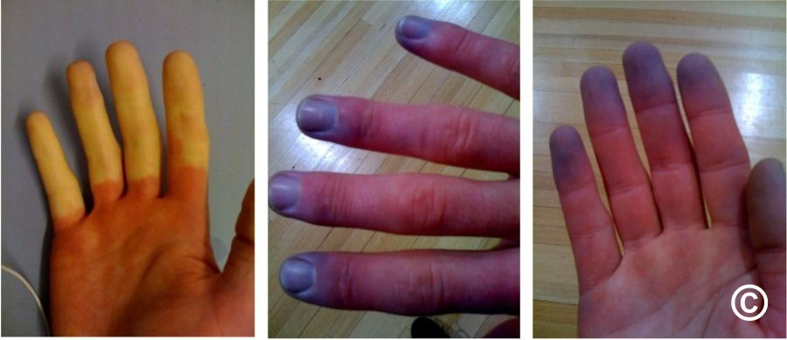

Slide 11
Features in favour of secondary Raynaud’s phenomenon include
Age at onset of over 25 years
Absence of a family history of Raynaud’s phenomenon
Unilateral presentation
Occurrence in a male

Slide 12
Examination of capillary nail-fold loops shows loss of the normal loop pattern, with capillary ‘fallout’ and dilatation and branching of loops *
If Raynaud’s phenomenon is severe, digital ulceration can occur
Notes:
*; these features support either a diagnosis of systemic sclerosis or severe primary Raynaud’s phenomenon.

Slide 13
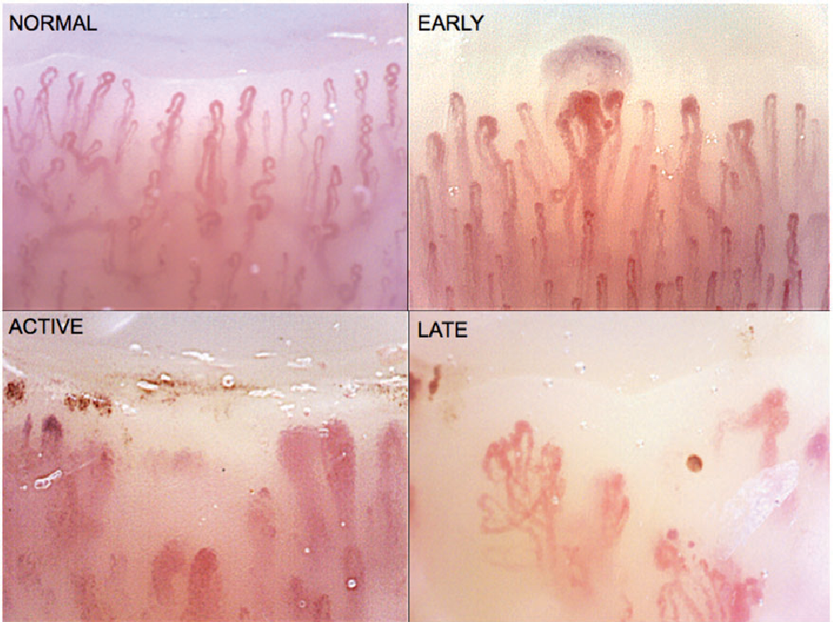

Slide 14
Skin
SLE skin eruptions are precipitated by exposure to UV light
The classic facial rash (20%)–(erythematous,falt or raised and painful or itchy, and occurs over the cheeks with sparing of the nasolabial folds)
A discoid rash (Hyperkeratosis and follicular plugging, with scarring alopecia)
Diffuse, usually non-scarring alopecia, occur with active disease

Slide 16
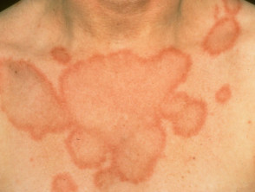
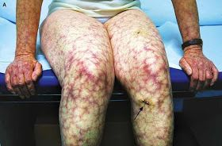
Subacute: Resembles tinea corporis with erythematous, irregular edges and central clearing (Positive SSA [Anti-Ro])
Livedo reticularis (feature of antiphospholipid syndrome)

Slide 17
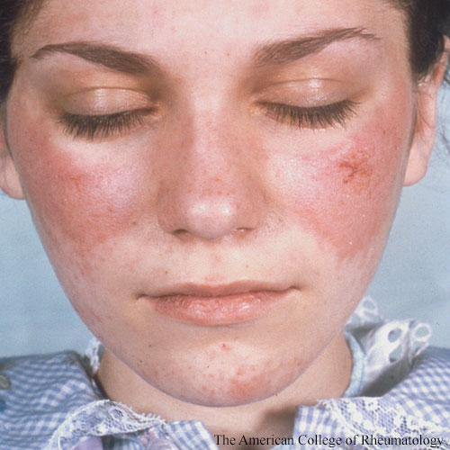
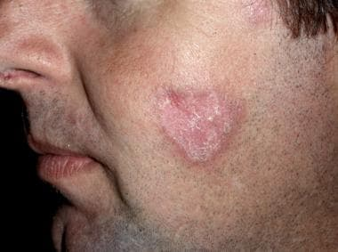
Malar Rash
Discoid Rash

Slide 18
Kidney
Renal involvement is the main determinants of prognosis and regular monitoring of urinalysis and blood pressure is essential
The typical renal lesion is a proliferative glomerulonephritis , characterised by heavy
Hematuria
Proteinuria
Casts

Slide 20
Cardiovascular
Carditis
Pericarditis (Most Common)
Myocarditis
Libman–Sacks endocarditis (due to sterile fibrin containing vegetation's on the heart valves , associated with antiphospholipid antibodies)
Atherosclerosis with is the risk of stroke and myocardial infarction

Slide 21
Libman–Sacks Endocarditis
Notes:
Verrucous vegetations seen in Libman-Sacks endocarditis of the mitral valve. The sterile fibrofibrinous vegetations seen in LS endocarditis of the mitral valve may vary in size and typically have a wart-like morphology. They can be found near the edge of the leaflets along the line of closure; both on the atrial and ventricular sides of the leaflets.

Slide 22
Lung
Pleuritic pain (Serositis*) or pleural effusion- most common
Pneumonitis
Atelectasis
Reduced lung volume ( Shrinking Lung Syndrome)
Pulmonary Fibrosis
Pulmonary thromboembolism (Antiphospholipid antibodies )
Notes:
Pleuritis (common) Bilateral (should be)
Consider infection if unilateral presentation and a history of immunosuppression
Shrinking lung syndrome (SLS) is a rare pulmonary complication of systemic lupus erythematosus (SLE). It is characterized by progressive dyspnea, elevation of diaphragm, pleuritic chest pain, decreased lung volumes on imaging, and restrictive pattern seen in the pulmonary function tests (PFTs)

Slide 24
Question 1
A 27-year-old female with SLE is referred with new onset pleuritic chest pain
She has a history of arthritis and mucositis, controlled on NSAIDs and antimalarial agents
She has a history of two second trimester miscarriages
On examination she has sinus tachycardia, RV heave, and a loud P2
Diffuse livedo reticularis is noted
Lung examination is clear and CXR appears normal apart from slightly oligemic fields
She is mildly hypoxic and in distress
What is the most likely diagnosis?

Slide 25
Notes:
Chest radiograph demonstrating focal oligemia in the right lung (area between white arrowheads) and a prominent right descending pulmonary artery (black arrow)

Slide 26
Answer: Pulmonary Embolus
SLE with antiphospholipid syndrome (APS) with a history of recurrent pregnancy loss and livedo reticularis
Her examination reveals elevated right-sided pulmonary pressure consistent with right ventricular strain
APS is a disease of recurrent vascular thrombosis and/or fetal loss associated with antibodies to membrane phospholipids
Approximately 40% of patients with SLE have anticardiolipin antibodies but only 10% have APS syndrome

Slide 27
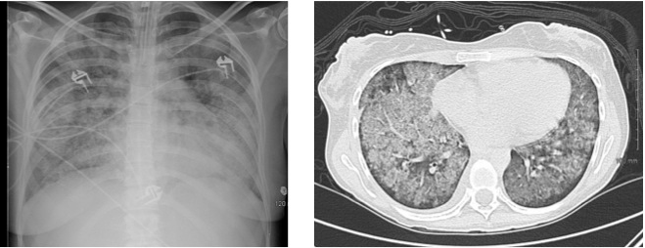
Question 2
A 22-year-old female presents with acute dyspnea and hemoptysis
On examination afebrile but tachypneic
She has oral ulcerations, a malar rash and arthritis of her left wrist Cardiac exam reveals sinus tachycardia with normal JVP & no added heart sounds but there is diffuse bibasilar crepitation's
Her CXR shows diffuse hazy infiltrates and she is treated empirically with broad spectrum antibiotics and supportive care.
She was admitted to Medical Ward but She fails to improve

Slide 28
Her basic labs: Hb 9.5, g/dl MCV 90, Platelets 65, WBC 12,000 without left shift
Her metabolic profile is normal and no evidence for bacterial, fungal, viral or mycobacterial organisms are found
ANA is 1:230 dilutions. Anti-double stranded-DNA 55 (elevated), serum complements are normal
On day 3 her hemoglobin (Hb) drops to 6 g/dl and she is transferred to the Intensive Care unit
What is the most likely diagnosis ?

Slide 29
Answer: Diffuse Alveolar Hemorrhage (DAH)
New Onset of Pulmonary Infiltrates
Sudden Drop of Hemoglobin
Worsening Respiratory Function
SLE as evidenced by
Malar rash
Thrombocytopenia
Arthritis
Positive serologies
Notes:
Paradoxically diffusion capacity in stable patients with a recent hemorrhage is elevated.
Since this is life threatening the patient should have bronchoscopy to confirm the diagnosis and then pulse dose intravenous corticosteroids.
If the patient has concomitant vasculitis, cytotoxics and plasmapheresis should also be considered

Slide 30
Neurological
Non specific features Fatigue, headache and poor concentration
Specific features
Visual Hallucinations
Chorea
Organic Psychosis
Transverse Myelitis
Lymphocytic Meningitis

Slide 31
Haematological
Neutropenia
Lymphopenia*
Thrombocytopenia
Haemolytic anaemia
*The degree of lymphopenia is a good guide to disease activity.
Antibody-mediated destruction of peripheral blood cells

Slide 32
Question 3
A 24-year old female presents with inspiratory chest pain, arthritis and fatigue
Her BP 102/80, Pulse 114, respiratory Rate 22, temperature 37.4°C
Conjunctival pallor with mild scleral icterus, sinus tachycardia and a right pleural rub
She has polysynovitis of the hands, wrists and elbows but no organomegally or abdominal tenderness
Her neurologic exam is intact

Slide 33
Laboratory Data:
Hb 6.7 g/dL,
WBC 2.4 × 109 L-1,
Platelets 6 × 10^9 L-1,
Creatinine 0.9 mg/dL,
urinalysis normal
LDH 645 U/L
ALP 50 U/L,
AST 45 U/L
ALT 35 U/L
Total Bilirubin (Bn) 3.5 mg/dL, indirect Bn 3.0 mg/dL.
ANA: 1:640 dilutions
Positive Anti-Sm/Ds-DNA antibodies
Complement C3/4 are both normal
On peripheral blood smear: Polychromasia and spherocytes are seen
What is the most likely diagnosis?

Slide 34
Answer: Evans syndrome (ES) with SLE
SLE as evidenced by
Arthritis
Serositis
Antibodies consistent with SLE
+
Severe thrombocytopenia & Autoimmune Hemolytic Anemia (AIHA)
ES is a rare syndrome characterized by AIHA and immune mediated thrombocytopenia (ITP) and/or immune mediated neutropenia
Notes:
Treatment initially is with high dose corticosteroids or intravenous Immunoglobulin (IVIg)

Slide 35
Gastrointestinal
Mouth ulcers (May or may not be painful)
Peritoneal serositis
Mesenteric vasculitis (abdominal pain, bowel infarction or perforation)
Hepatitis

Slide 36
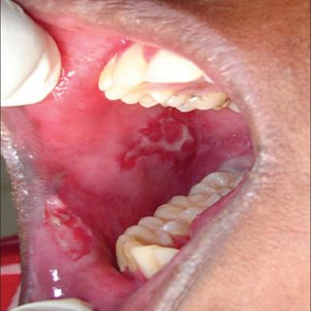

Slide 37
Paediatric disease
A higher incidence in juvenile-onset SLE of
Malar rash
Cutaneous vasculitis
Raynaud’s phenomenon
Neuropsychiatric manifestations
Renal disease

Slide 38
Diagnosis
The diagnosis is based on a combination of clinical features and laboratory abnormalities
Checking of ANAs (Disease Hallmark) , antibodies to ENAs and complement, routine haematology, biochemistry and urinalysis are mandatory*
Anti-dsDNA antibodies are positive in 50-70% and may have role in disease activity
Notes:
ANA
Present in 98% to 99% of SLE (Disease Hallmark)
Not specific (only 5% of people with a positive ANA will develop SLE)
ANA negative patients unlikely to have or develop SLE
The most appropriate methodology for testing ANA is the indirect immunofluorescence assay, which is highly sensitive (95%.) for SLE.
ANA tests should be interpreted in the context of the probability of disease because ANA may be present in other autoimmune diseases, and low-titer positivity may be seen with aging and even in healthy individuals. A small percentage of patients with SLE are negative for ANA but poslt1ve for antl-Ro/SSA antibodies.
A negative ANA plus a negative antiRo /SSA essentially rules out SLE

Slide 39
Question 4
A 23-year-old woman is pregnant with her first child
She undergoes screening ultrasonography at five months gestation and the fetus is determined to have an abnormally low heart rate, although it appears to be otherwise normal
Serologic screening of the mother is most likely to reveal which of the following autoantibodies? A. Anti-Ro B. Anticentromere C. Antidouble-stranded DNA D. Anti-Jo-1 E. Anti-Mi2

Slide 40
Answer A
Anti-Ro antibodies are associated with congenital heart block and cutaneous eruptions in affected neonates, as well as photosensitive eruptions in adults and Sjögren’s syndrome

Slide 41
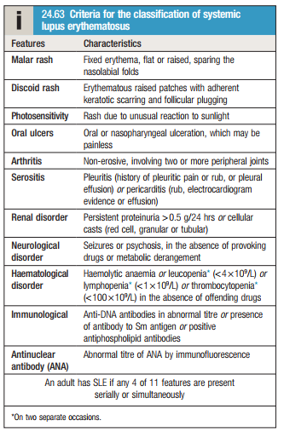
Notes:
The Systemic Lupus International Collaborating Clinics (SLICC) criteria used in the classification for SLE
The 2012 SLICC criteria replaced the 1997 ACR criteria because of possessing better sensitivity (97%) although specificity was less (84%).
Any person who satisfies four or more of the following clinical and immunologic criteria including at least one clinical criterion and one immunologic criterion, or any person who has biopsy-proven lupus nephritis in the presence of a positive ANA or anti-dsDNA antibodies is considered to have SLE for the purposes of clinical studies

Slide 42
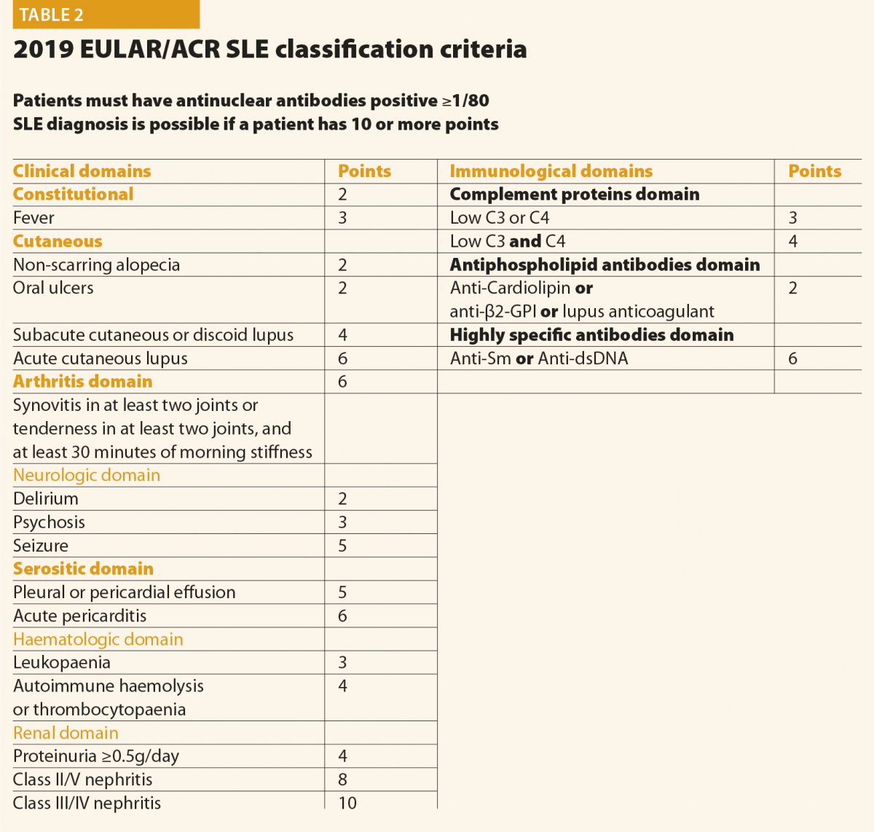
2019, EULAR and ACR
High sensitivity (96%) and specificity (93%)
A patient was classified as having SLE if they had a positive ANA ≥1:80 and had ≥10 points

Slide 43
Patients with active disease tend to have low levels of C3 due to complement consumption, but in some people low C3 and C4 may be the result of inherited complement deficiency in C1, C2 or C4 that predisposes to SLE .*
Notes:
*Studies of other family members can help to differentiate inherited deficiency from complement consumption.

Slide 44
A raised ESR, leucopenia , lymphopenia, haemolytic anaemia and thrombocytopenia are typical of active SLE
CRP is often normal in active SLE, except in the presence of
Serositis
Overwhelming infection
Vasculitis
Notes:
The ESR may remain elevated despite of the disease control (persistent polyclonal gammopathy)
CRP usually does not rise greater than six times the upper limit of normal even during a disease flare unless there is
Systemic vasculitis
Significant serositis
Associated infection
WBC drop with SLE activity & with infection (but more likely with an SLE flare)
WBC can be deceivingly “normal” in an infected SLE patient (low baseline WBC due to their SLE)
WBC differential showing a “left shift” is concerning for infection
Beware of the febrile SLE patient who “normalizes” their WBC count
Complement levels often rise in the setting of infection and drop with a SLE flare
An elevated Procalcitonin level or lactate may be suggestive of a bacterial infection in a febrile SLE patient

Slide 46
Management
Education
Patients should be advised to avoid sun and ultraviolet light exposure and to employ sun blocks (sun protection factor 25–50)

Slide 47
Mild to Moderate Disease (Disease Restricted to Skin and Joints)
Managed with
Analgesics
NSAIDs
Hydroxychloroquine
Glucocorticoids (prednisolone 5–20 mg/day), in combination with immunosuppressants such as methotrexate, azathioprine or mycophenolate mofetil (MMF) in more severe cases
Belimumab: Monoclonal antibody targets the β-cell growth factor BLyS

Slide 48
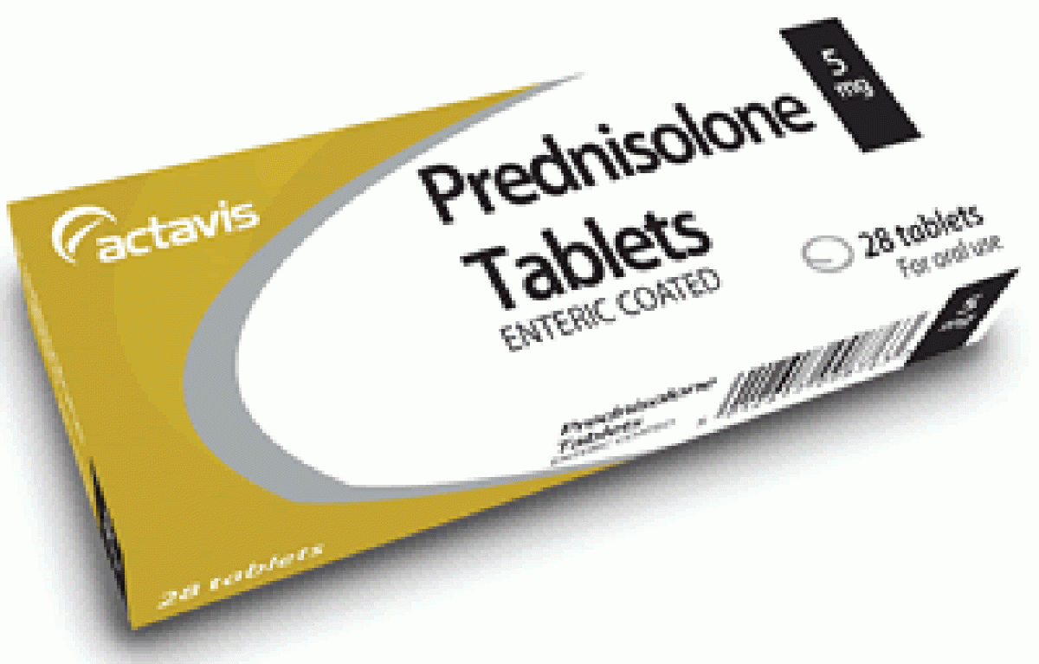

Slide 49
Severe and Life-threatening Disease
Renal, CNS and Cardiac Disease
Pulsed Methylprednisolone (10 Mg/Kg IV) Plus Cyclophosphamide (15 Mg/Kg IV), Repeated at 2–3-weekly intervals for six cycles.
Cyclophosphamide side effects
Haemorrhagic Cystitis
Azoospermia and Premature Menopause

Slide 51
MMF has been used successfully with high-dose glucocorticoids for renal involvement with results similar to those of pulsed cyclophosphamide but fewer adverse effects

Slide 52
Maintenance therapy
Oral prednisolone in a dose of 40–60 mg daily, gradually reducing to 10–15 mg/day or less by 3 months.
Plus
Azathioprine (2–2.5 mg/kg/day), methotrexate (10–25 mg/week) or MMF (2–3 g/day)
The long-term aim is to continue the lowest dose of glucocorticoid and immunosuppressant to maintain remission.

Slide 53
Control of cardiovascular risk factors(hypertension and hyperlipidemia) and smoking Cessation .
Patients with SLE and the antiphospholipid antibody syndrome, who have had previous thrombosis, require life-long warfarin therapy.
SLE patients are at risk of osteoporosis and hypovitaminosis D, and should be screened with biochemistry and DXA scanning accordingly

Slide 54
Question 5
A 25-year-old female with a 5-year history of SLE presents with increasing edema of 1-week duration. Her medications include hydroxychloroquine 200 mg twice daily
Lab data reveal Hb = 10.5g/dl, WBC = 3.2x109/L, and creatinine = 0.6 mg/dl
Urinalysis shows 4+ proteinuria, red cell casts, and active sediment
A renal biopsy shows active glomerulonephritis interpreted as stage IV active diffuse proliferative glomerulonephritis (DPGN)
How would you manage this condition?

Slide 55
Answer Treat with Mycophenylate Mofetil
The standard of care has been pulse dose methylprednisolone with intravenous cyclophosphamide given initially as monthly pulses and subsequently quarterly for a 2-year period
Patients with SLE who have received IV cytoxan have a higher risk of infertility
For this patient mycophenylate mofetil is a better alternative with equal efficacy and less toxicity

Slide 57
